Slide 1
Memory intro

Slide 2
Learning intention: to understand the multi-store model of memory (Atkinson & shiffrin)
Success criteria:
Categorise memories as declarative (explicit) or non-declarative (implicit)
describe the sensory register, short-term memory and long-term memory
Explain how these work together

Slide 3
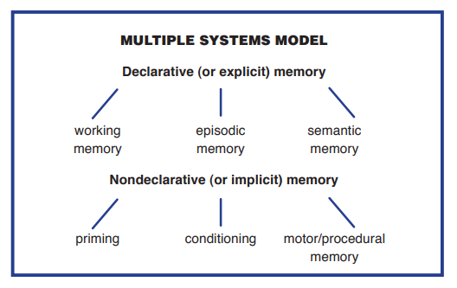

Slide 4
Declarative (explicit) memory
controlled consciously, intentionally, and flexibly. involves some effort and intention
mediated by the hippocampus and frontal lobes
people with damage to the hippocampus have difficulty forming new long-term declarative memories, while those with frontal lobe damage may experience deficits in working memory.
measured with explicit memory tests
It generally declines with age.
Examples: recalling the name of an old friend, remembering a list of items to pick up at the store, remembering information for a test, learning a phone number, and recalling your PIN number

Slide 5
Nondeclarative (implicit) memory
influences our current perceptions and behavior without our knowledge, awareness, or intention.
assessed with an implicit memory test in which the individual is unaware she or he is taking a memory test.
mediated by cortical areas, the cerebellum, and the basal ganglia.
Damage to the cerebellum and basal ganglia can impair classical conditioning and procedural memory.
first discovered in work with people who had anterograde amnesia
It remains relatively stable with normal aging.
Examples: riding a bike, driving a manual car, using the same verbal patterns as friends (e.g., saying “like” repeatedly), and classical conditioning.

